Slide 1
Mark 10 : 17-31

Slide 2
¹⁷ And as he was setting out on his journey, a man ran up and knelt before him and asked him, “Good Teacher, what must I do to inherit eternal life?” ¹⁸ And Jesus said to him, “Why do you call me good? No one is good except God alone. ¹⁹ You know the commandments: ‘Do not murder, Do not commit adultery, Do not steal, Do not bear false witness, Do not defraud, Honour your father and mother.’ ” ²⁰ And he said to him, “Teacher, all these I have kept from my youth.” ²¹ And Jesus, looking at him, loved him, and said to him, “You lack one thing: go, sell all that you have and give to the poor, and you will have treasure in heaven; and come, follow me.” ²² Disheartened by the saying, he went away sorrowful, for he had great possessions.

Slide 3
²³ And Jesus looked around and said to his disciples, “How difficult it will be for those who have wealth to enter the kingdom of God!” ²⁴ And the disciples were amazed at his words. But Jesus said to them again, “Children, how difficult it is to enter the kingdom of God! ²⁵ It is easier for a camel to go through the eye of a needle than for a rich person to enter the kingdom of God.” ²⁶ And they were exceedingly astonished, and said to him, “Then who can be saved?” ²⁷ Jesus looked at them and said, “With man it is impossible, but not with God. For all things are possible with God.”

Slide 4
²⁸ Peter began to say to him, “See, we have left everything and followed you.” ²⁹ Jesus said, “Truly, I say to you, there is no one who has left house or brothers or sisters or mother or father or children or lands, for my sake and for the gospel, ³⁰ who will not receive a hundredfold now in this time, houses and brothers and sisters and mothers and children and lands, with persecutions, and in the age to come eternal life. ³¹ But many who are first will be last, and the last first.”

Slide 5
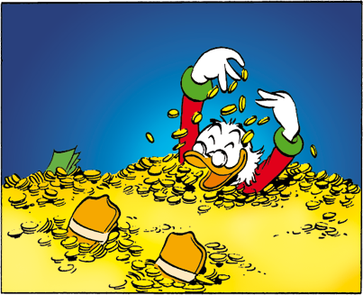

Slide 6
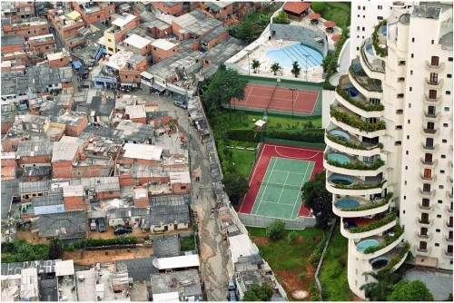
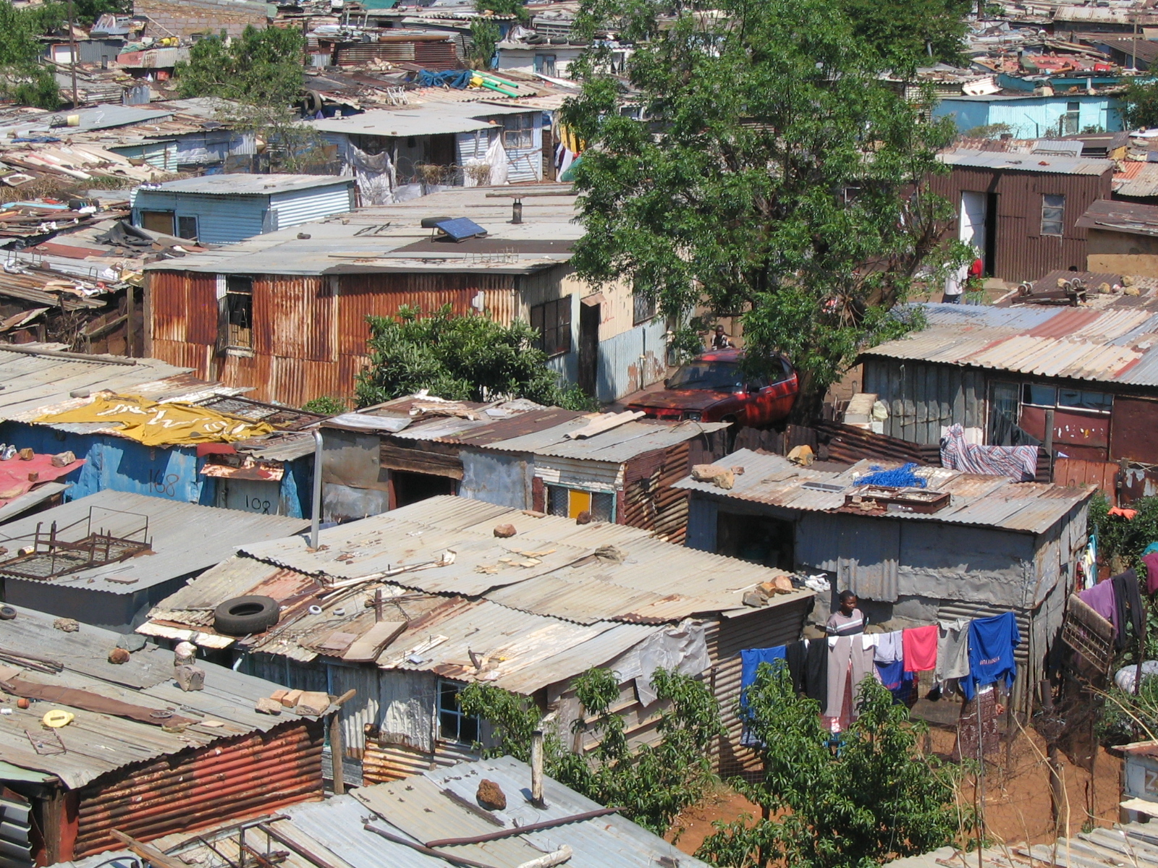
By historic standards, we are rich
By world standards, we are rich

Slide 7
The Gospel of Mark Reveals who Jesus is – The Christ, the Son of God
The Goodness of Jesus reveals the divinity (Godness) of Jesus
“Good Teacher, what must I do to inherit eternal life?”
Jesus loves it when we keep His commands; He loves it when we live righteously
But an external demonstration of keeping the Law isn’t enough (something lacking)
Didn’t love God with his whole heart
Didn’t love his neighbour as himself
²¹ And Jesus, looking at him, loved him, and said to him, “You lack one thing: go, sell all that you have and give to the poor, and you will have treasure in heaven; and come, follow me.” ²² Disheartened by the saying, he went away sorrowful, for he had great possessions.

Slide 8
²³ And Jesus looked around and said to his disciples, “How difficult it will be for those who have wealth to enter the kingdom of God!” ²⁴ And the disciples were amazed at his words. But Jesus said to them again, “Children, how difficult it is to enter the kingdom of God! ²⁵ It is easier for a camel to go through the eye of a needle than for a rich person to enter the kingdom of God.” ²⁶ And they were exceedingly astonished, and said to him, “Then who can be saved?” ²⁷ Jesus looked at them and said, “With man it is impossible, but not with God. For all things are possible with God.”
Hyperbole – an over-the-top statement, not meant to be taken literally, but given to make a point. From Jesus’ mouth: It is actually true.
It’s impossible for a rich person to enter the Kingdom of God
But by the Grace of God & a Miracle of God, a rich person can enter His Kingdom
Jesus is shaking us to understand: What we do, with what we have, has eternal consequences (eternal rewards... our very place in eternity at all)
One thing you lack
Sell all you have
Give to the poor
Come, follow Me

Slide 9
It’s impossible for a rich person to enter the Kingdom of God
But by the Grace of God & a Miracle of God, a rich person can enter His Kingdom
Jesus is shaking us to understand: What we do, with what we have, has eternal consequences (eternal rewards... our very place in eternity at all)
One thing you lack
Sell all you have
Give to the poor
Come, follow Me
He didn’t have an eternal perspective.
He cared more about his worldly wealth & possessions
He didn’t love God with his whole heart
He didn’t love his neighbour as himself
Becoming a Disciple of Jesus: Believe; Repent; Follow
All of his good works and keeping of the Law wasn’t enough
Repentance – A change of mind / change of direction – demonstrated by what we do
When Jesus calls us to follow, we must leave behind whatever hinders us
Love of money & Possessions Vs. Love of God & Love of others
Sin is so serious (eternal consequences), cut off the source of temptation
The more desperate I am to justify “having wealth”, the more I need to be rid of it
Those with an eternal perspective, hold wealth loosely

Slide 10
It’s impossible for a rich person to enter the Kingdom of God
But by the Grace of God & a Miracle of God, a rich person can enter His Kingdom
What we do, with what we have, has eternal consequences
Becoming a Disciple of Jesus: Believe; Repent; Follow
All of his good works and keeping of the Law wasn’t enough
Repentance – A change of mind / change of direction – demonstrated by what we do
When Jesus calls us to follow, we must leave behind whatever hinders us
Love of money & Possessions Vs. Love of God & Love of others
Sin is so serious (eternal consequences), cut off the source of temptation
The more desperate I am to justify “having wealth”, the more I need to be rid of it
Those with an eternal perspective, hold wealth loosely
Love God & Love Others, with everything we have
Jesus wasn’t ‘joking around’ when He said how hard it is for a rich person to enter the Kingdom of God.
Many who are first will be last, and the last first

